Slide 1

ALCOHOL SENSING ENGINE LOCK WITH GSM

Slide 2
TEAM MEMBERS
1. SAKSHI KHANORE (TEAM LEADER)
2.PRIYANKA JADHAV
3. NEHA KATAKE

Slide 3
INTRODUCTION
The alcohol detector and engine locking system is designed to prevent drunk driving, which is a major cause of accidents and fatalities on the road.
To address this issue, various technologies have been developed to prevent drunk driving, including the alcohol detector and engine Locking system.
In this system uses a compact Arduino Uno board. Programs are developed in embedded C Our project is based on prevention of drunk & driving. So in our project we use a MQ3 sensor, a DC motor, An Arduino board & a LCD display.
Here Arduino is used for the programming and interfacing purpose; LCD display is used to show the percentage of the alcohol present in alcoholic breath of the person, MQ3 sensor is used to detect the alcohol molecules. This sensor is placed on the steering of the car. When a driver tries to drive the car in over drunken condition, the MQ3 sensor senses the presence of alcohol and when the percentage level is above the stated value a signal will be send

Slide 4
APPLICATIONS
Road Safety: The primary application is to improve road safety by preventing drunk driving, a leading cause of accidents and fatalities globally. This system can significantly reduce the risk of accidents caused by impaired drivers.
Commercial Fleets: Commercial vehicle operators can deploy this system to ensure that drivers of trucks, buses, and delivery vehicles are sober before driving, reducing liabilities and promoting workplace safety.
Law Enforcement: Police or government bodies may use the system as part of public transport or government fleet vehicles to ensure that drivers are not under the influence of alcohol.

Slide 5
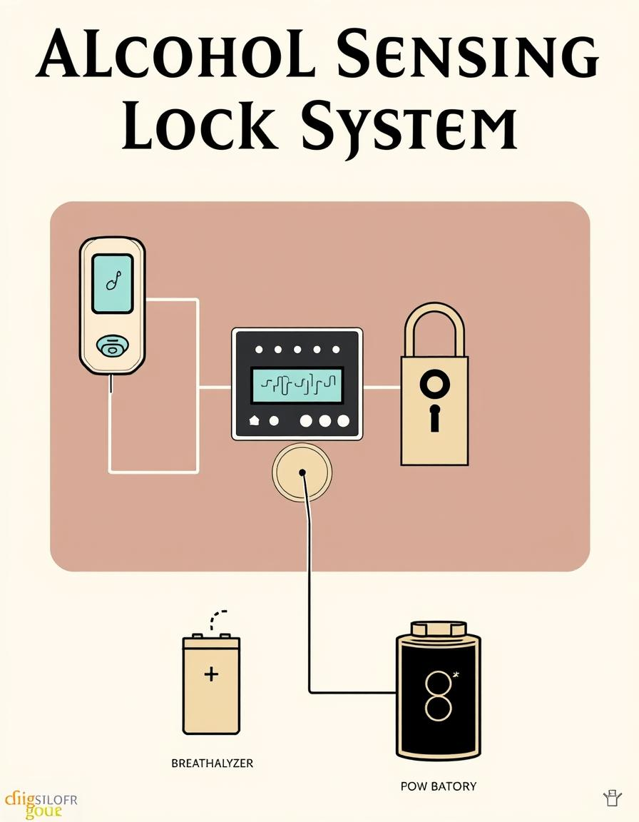
COMPONENTS USED
1. ARDUINO UNO :
2. MQ 3 SENSOR:
3.DC MOTOR
4.RELAY
5.BC 547 TRANSISTOR
6. 9V BATTERY
7. GPS AND GSM MODULE
8.LCD
9.PCB
10.RESISTORS AND CAPACITORS
11.DIODES

Slide 6
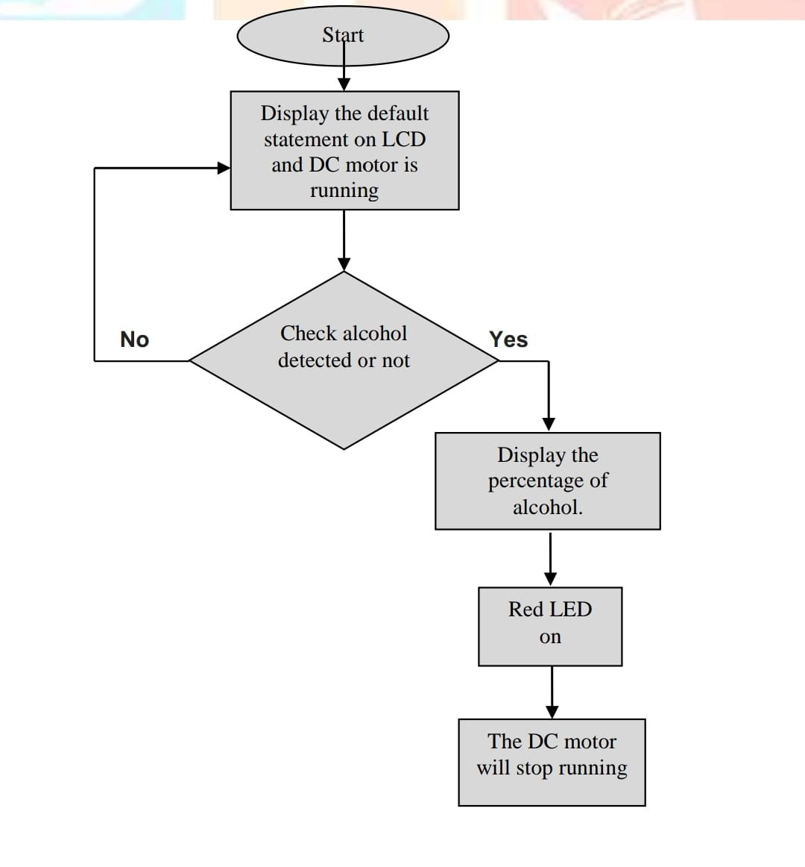
FLOW CHART

Slide 7
ADVANTAGES
The alcohol detector and engine locking system has several advantages in preventing drunk driving. First, it can accurately measure a driver's BAC level and prevent them from operating the vehicle if their level is above the legal limit. This reduces the risk of accidents caused by impaired driving. Second, the system can help to deter drunk driving by providing a visual reminder of the consequences of drinking and driving. Drivers are aware that they will not be able to operate their vehicles if they have consumed alcohol, which can discourage them from drinking and driving.

Slide 8
REFERENCES
SK.Singh and A.kumar, ”Alcohol Detection System for Drunk Drivers, ” International Journal of Innovative Research in Science , Engineering and Technology,vol-4,pp.11-14,2015.
R.K.Gupta and A.K.Sharma, ”Design and Development of Alcohol Detection System for Vehicle Safety, ” International Journal of Advanced Research in Computer Science and Software Engineering ,vol4,no-8,oo.1027-1030,2014.

Slide 9

THANK YOU

